Slide 1





Constrained Mixed-Critical Parallelization for Distributed Heterogeneous Systems
Authors:
Robert Höttger, Mustafa Özcelikörs, Philipp Heisigg,
Lukas Krawczyk, Carsten Wolff, Burkhard Igel
Presentation:
Mustafa Özçelikörs (2nd author)
IDiAL Institute – Dortmund University of Applied Sciences and Arts
Germany
Acknowledgements
The project is funded by BMBF Fund.Nb. 01-S14029K under Project AMALTHEA4public. A4MCAR project is also granted by The Eclipse Foundation and Google Inc. during Google Summer of Code 2017.

Slide 2
Contents
Introduction
Parallel Programming Basics
APP4MC
A4MCAR
Tracing
Modeling
Results

Slide 3
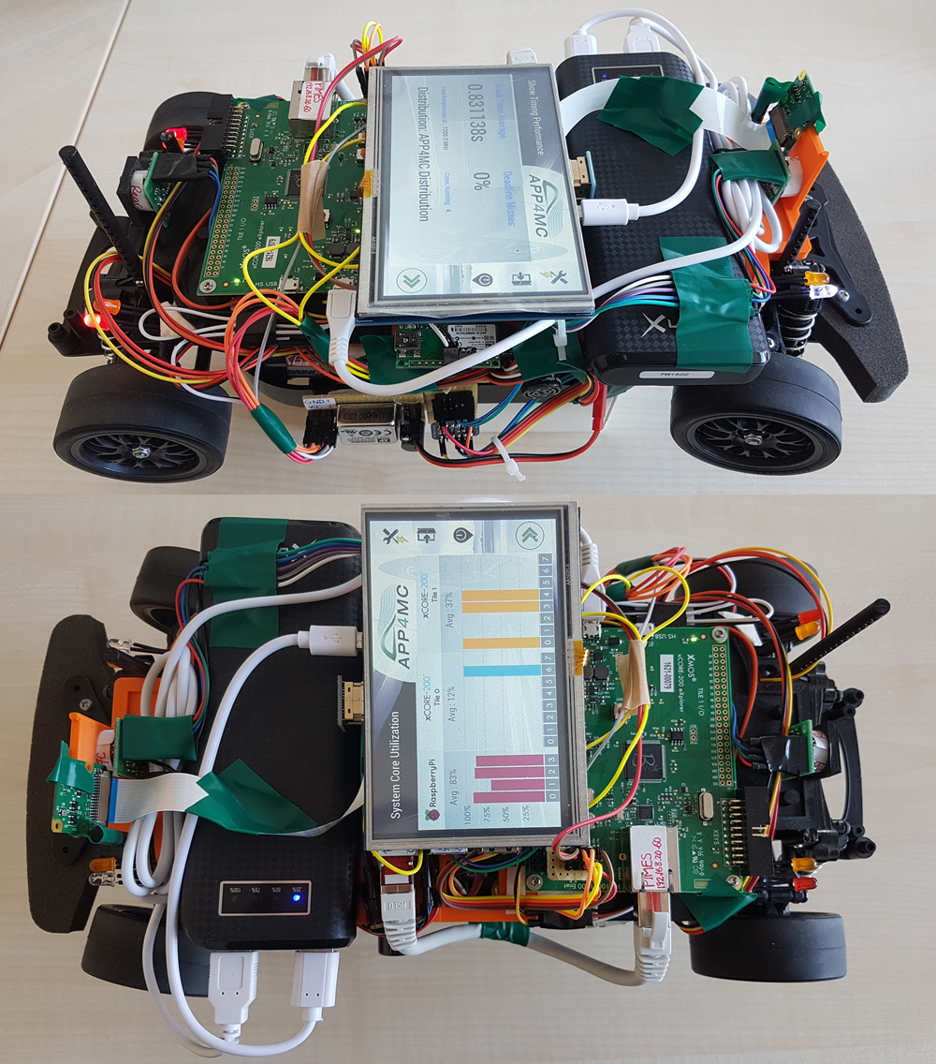
Introduction
Overview
Evolution of Apps, Multicore
APP4MC
Goal: “Open” model-based embedded multi-core platform
Automotive domain
Sw distribution through Sw and Hw modeling
A4MCAR
Goal: Demonstrator to test, tool support to supply APP4MC
Features schedulable and traceable software
Has many features
Tracing & distribution features involved for GNU/Linux

Slide 4
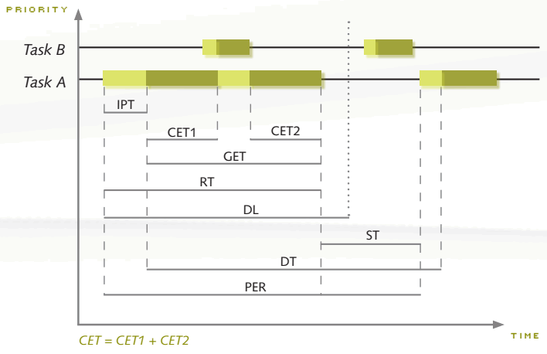
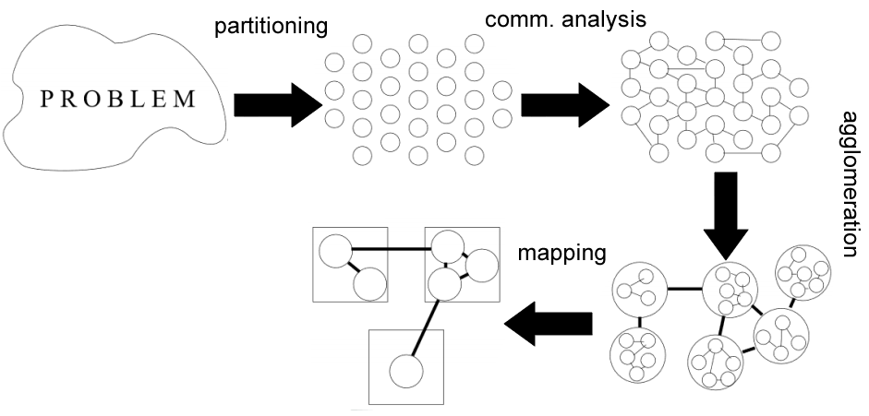
Basics
Basics
Runnable
Thread vs Process
Design Techniques
ST,
GET,
DL,

Slide 5
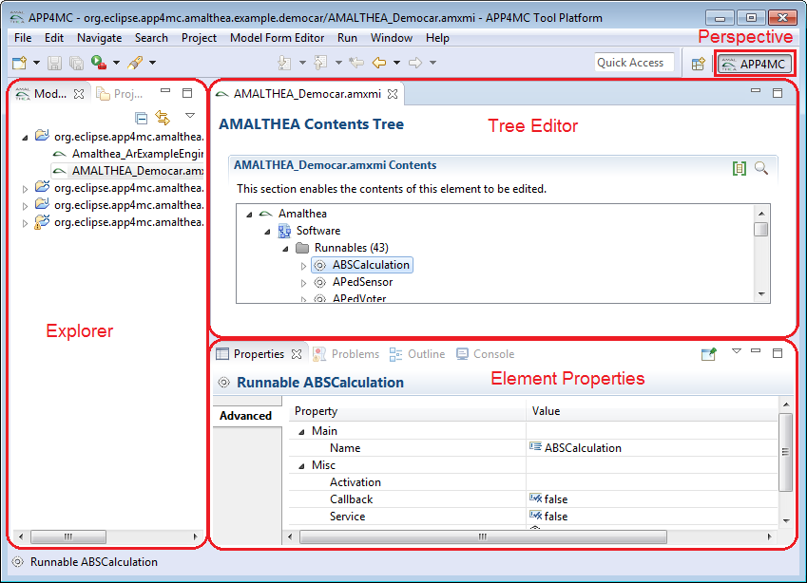
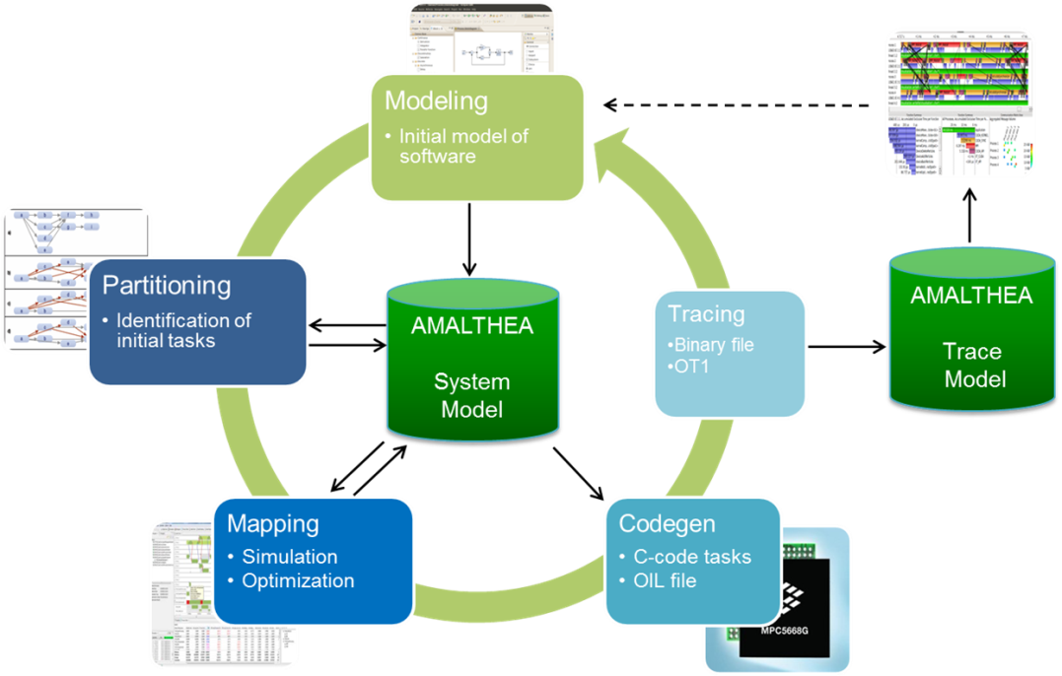
APP4MC
What is APP4MC?
Design Flow with APP4MC
Modeling
AMALTHEA models
Partitioning
ESSP, CPP
Generating Tasks
Mapping
ILP-based, GA-based load balancing
Reducing computation time
Optimization towards energy consumption

Slide 6
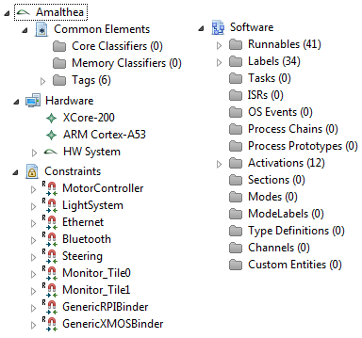
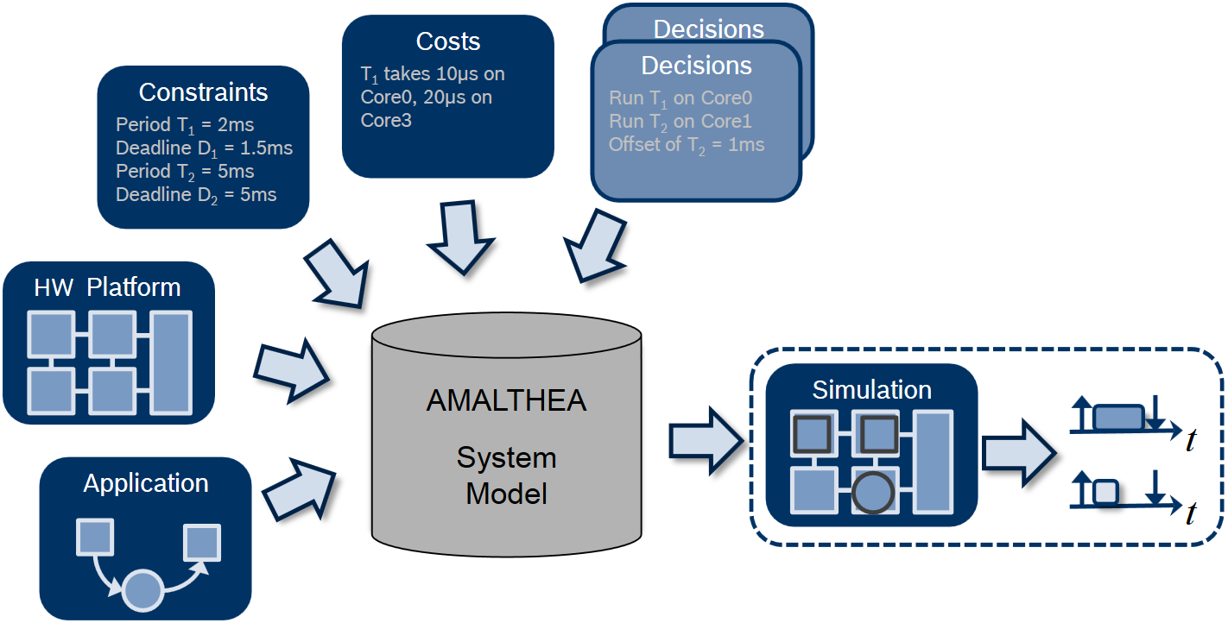
APP4MC
Modeling
XML-based AMALTHEA model

Slide 7
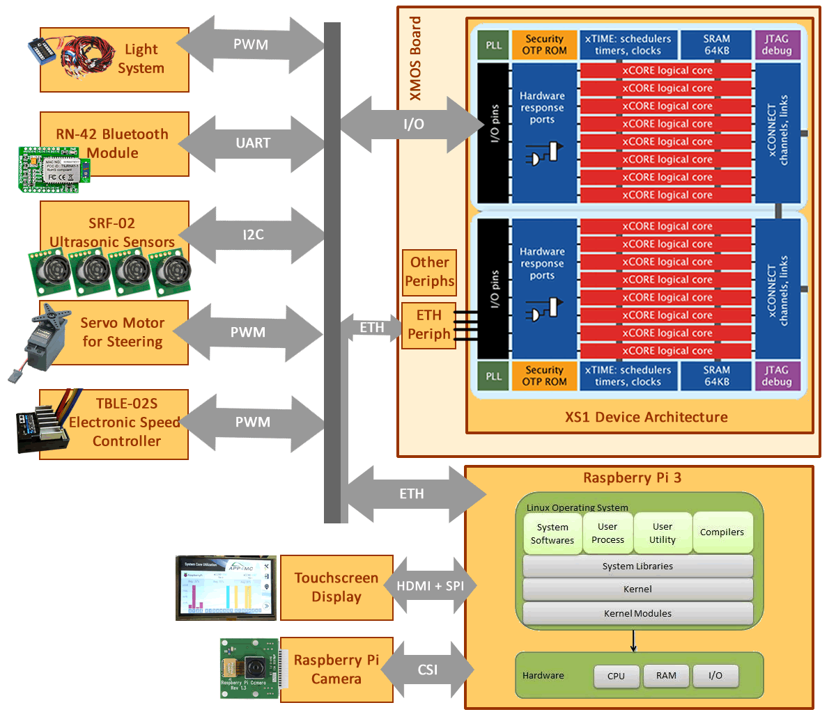
A4MCAR
Overall Look to A4MCAR
Hardware

Slide 8
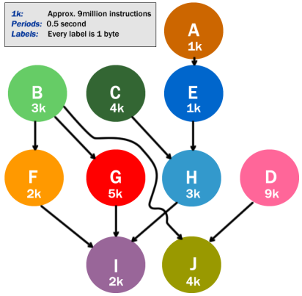
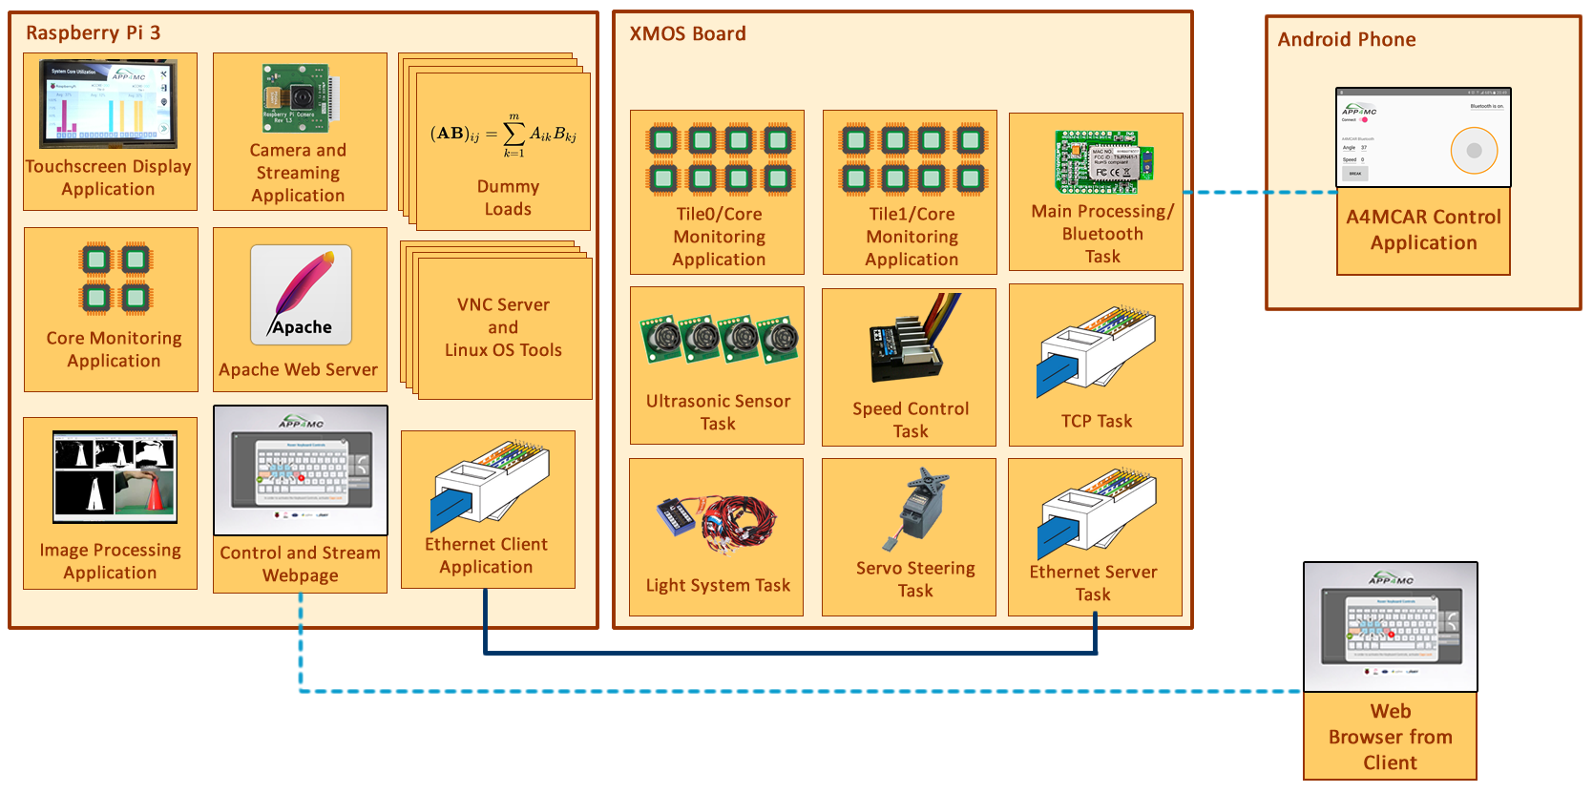
A4MCAR
Overall Look to A4MCAR
Software

Slide 9
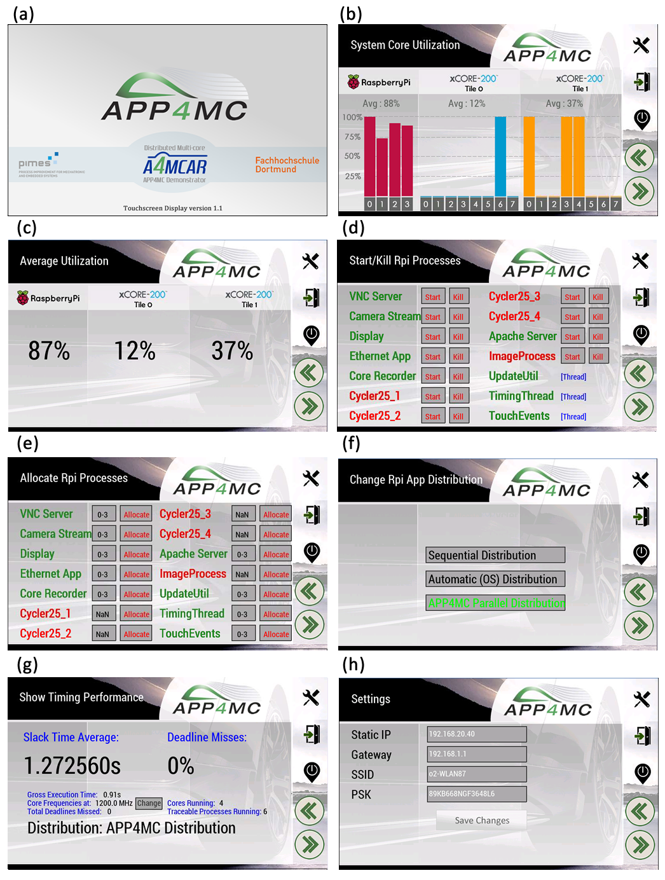
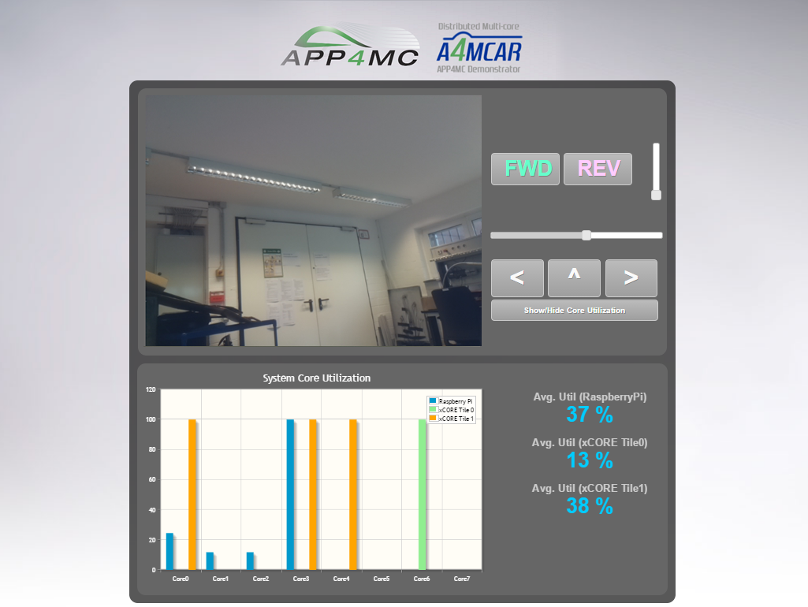
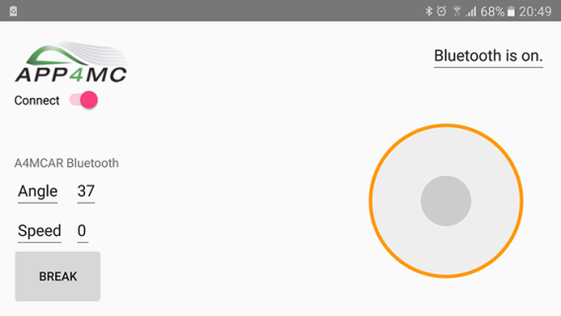
A4MCAR
Front-Ends

Slide 10
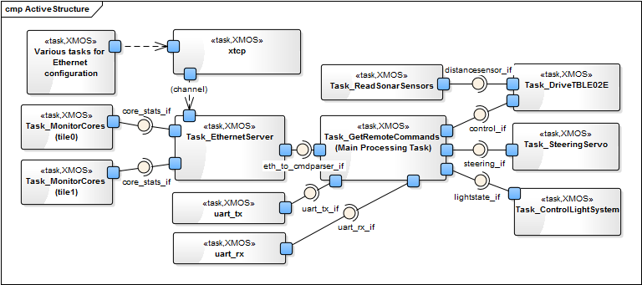
A4MCAR
Low-level Module Tasks
Overview

Slide 11
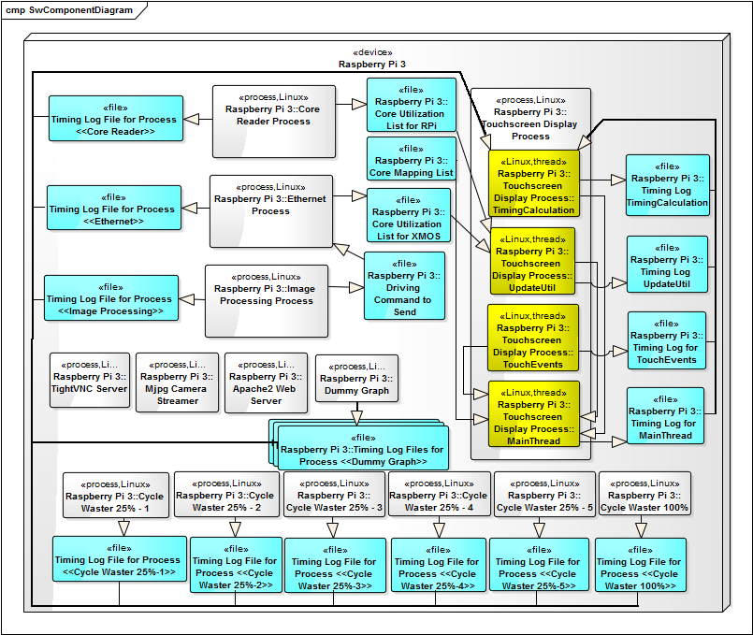
A4MCAR
High-level Module Tasks
Overview
ST, PER,
DL, GET
logged

Slide 12
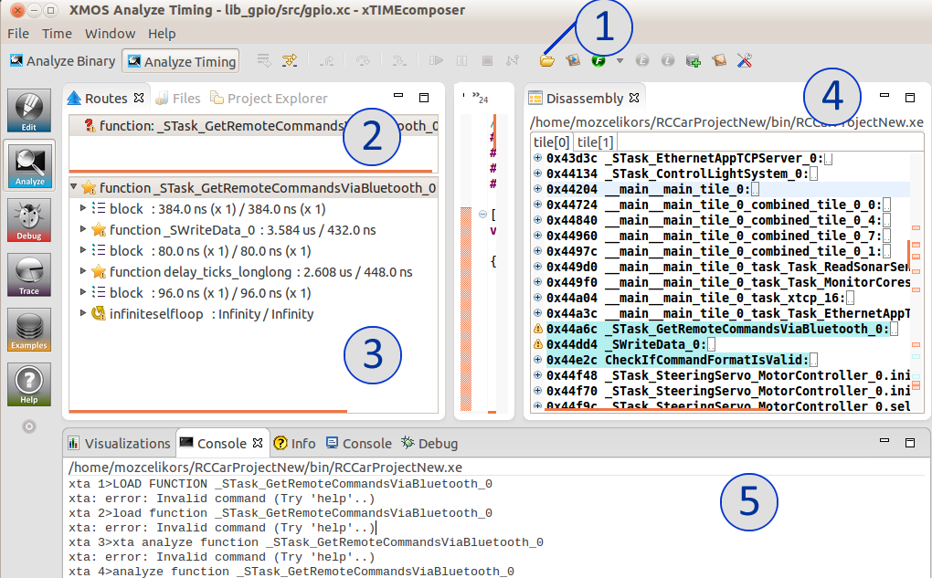
A4MCAR Gathering Information
Gathering Information to Model with AMALTHEA
What kind of Information Needed?
Instruction sizes of Runnables
Activation periods
Labels / label accesses
Tools Used & Configured
Low-level: XTA (xTIME Analyzer) for XMOS, Disassembly
High-level: perf stat

Slide 13
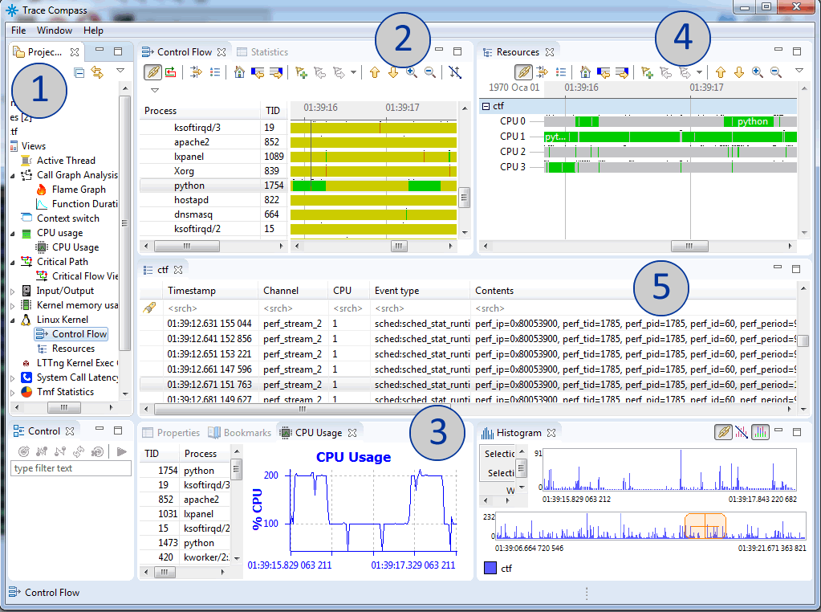
A4MCAR System Tracing
System tracing
Perf sched
Common Trace Format (CTF)
Eclipse TraceCompass

Slide 14
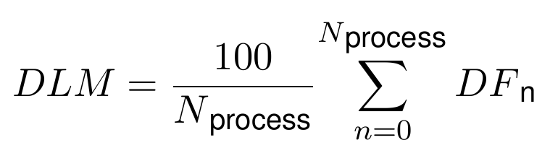
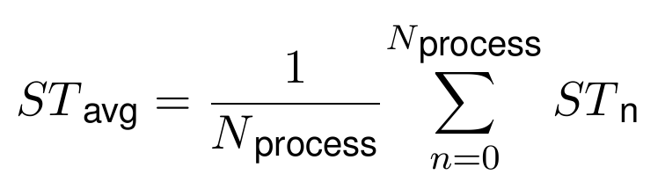
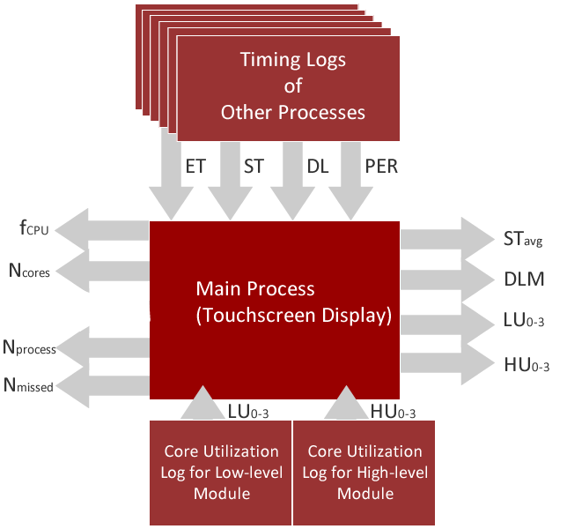
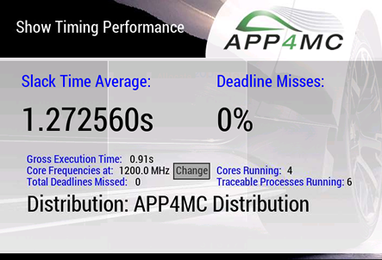
A4MCAR System Tracing
Implementations regarding evaluation metrics

Slide 15
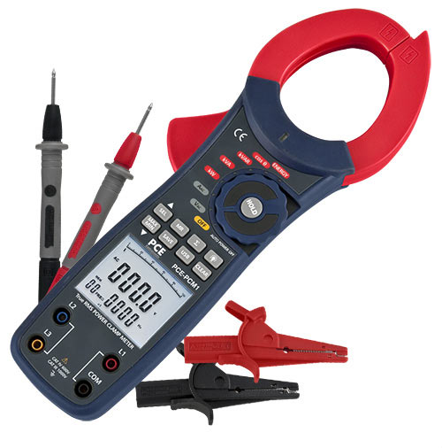
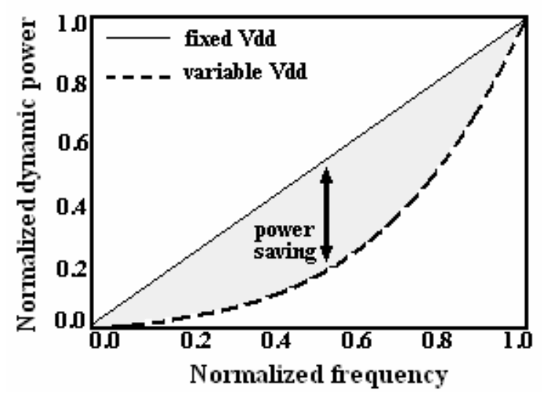
Reducing Power Consumption
We used a Clamp Meter
to measure current
Underclocking
cpufrequtils (in Linux)
core frequency registers (in XMOS)
Dynamic Voltage and Frequency Scaling (DVFS)
cpufrequtils
Active Energy Consumption (AEC) modes
halting a core when non-used
used

Slide 16
Modeling
Limitation
Non-exact model
Profiling errors and overheads (perf), System overheads (5%), Invisible OS elements
Sporadic activations are not allowed in APP4MC. Therefore, assumptions are involved.
Limitations and Constrains
Non-exact model
Profiling errors and overheads (perf), System overheads (5%), Invisible OS elements
Sporadic activations are not allowed in APP4MC. Therefore, assumptions are involved.
Strict dependencies in APP4MC’s Partitioning
OS does not ensure dependencies, while APP4MC ensures it.
More dependency-loose bin-packing algorithms are now being developed.
Static scheduling approach
APP4MC -> static scheduling approach, OS -> dynamic scheduling, migration involved
XMOS hardware and tooling limitations
Unresolvable sections of code.
Disassembly counting involved.
Core Utilization tracing using registers are only valid for periodic tasks, and are non-exact.
XMOS Application Functionality vs Transparency
Using third party libraries make it harder to have a traceable, distributable system.
Load-balancing limitations of APP4MC
Partitioning algorithms use activation-dependent grouping
Mapping algorithms focuses on reducing max. Computation time.
New approaches will consider n-stage algorithms to also consider load-balancing.

Slide 17
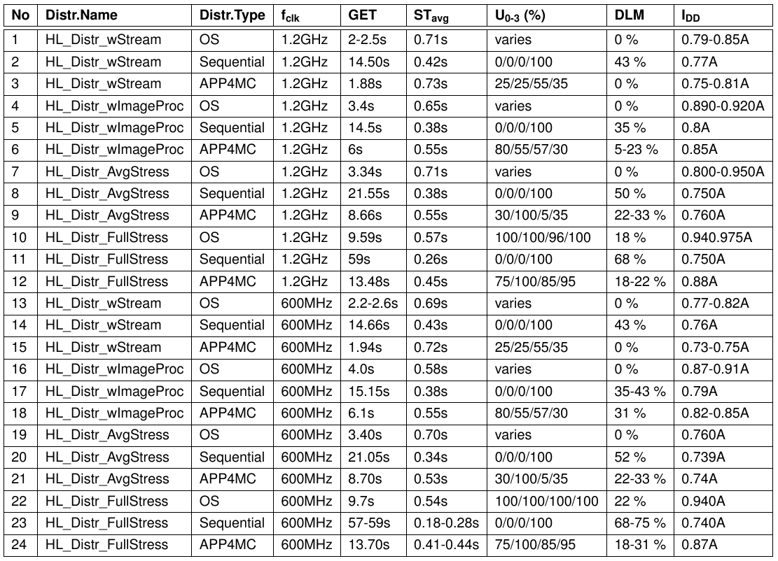
Results (Partitioning + Mapping)
(ESSP, 10 partitions, GA) OS, Sequential, APP4MC,
1 distr scored better, sign. impr. GET
Power cons. improved
HL Comparison &Evaluation

Slide 18
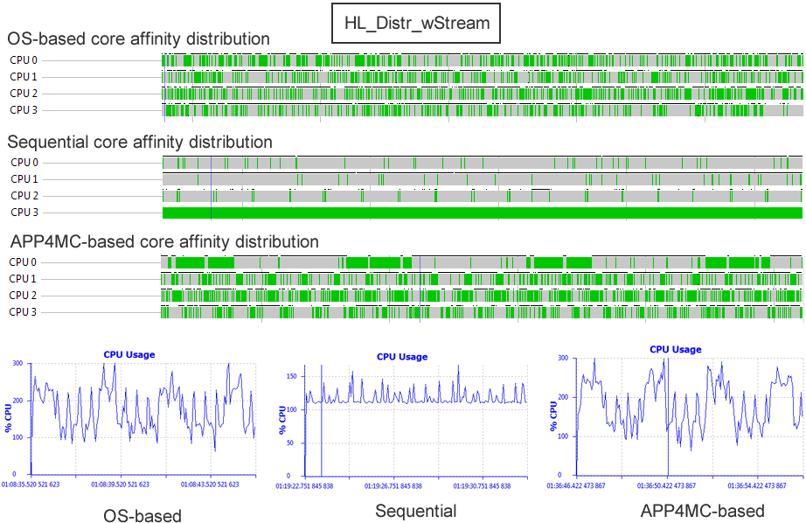
Results
Traces (from Eclipse TraceCompass)
OS: dynamic scheduling, migrations,
Context switches

Slide 19
Conclusions
Reasoning & Conclusion
A4MCAR has its limitations,
System overheads, profiling overheads, non-exact model.
APP4MC is real-time and ensures causal order.
CFS -> very fair, therefore non real-time.
Using RT patch (preemptRT) in Linux is a solution.
APP4MC targets more fine-grained, lower-level, higher-scale systems.
Static scheduling is not the best to approach OS systems.
APP4MC has its limitations,
OS systems are not entirely targeted (New algorithms are being developed)
Sporadic activations (often in OS) are not supported.
Optimizes towards reducing computation time rather than load balancing.
APP4MC uses static-scheduling and base multi-core computing on models.
APP4MC is a suggestive, supplementary tool.

Slide 20
Thanks for Your Attention !

